Slide 1


Artificial Intelligence and Data Science
Data Science and Visualization
24ADI204
DATA-VIZ HACK-A-BIT (2026-2027)
MID REVIEW (September 2026)
Team Number: 08
Ames Housing Price Prediction & Valuation Analysis
End-to-End Data Science & Visualization Pipeline (Weeks 1 to 7 Progress)
Tarun B S
Reg No: 25BAD123
Data Analysis & Visualization
Santhosh P
Reg No: 25BAD101
Data Cleaning & Preprocessing
Siva Chandran R K
Reg No: 25BAD108
Feature Engineering & Modeling
Santhosh M
Reg No: 25BAD100
Documentation & Presentation

Slide 2
Problem Statement
The Real Estate Valuation Dilemma
Market Complexity & Appraisal Inconsistencies
• Non-Linear Value Drivers: Property prices are governed by intricate interactions among physical square footage, craftsmanship, building age, and neighborhood micro-location.
• Asymmetric Information: Buyers, appraisers, and mortgage lenders face substantial price ambiguity caused by subjective amenity ratings and inconsistent quality disclosures.
• Severe Financial Consequences: Inaccurate home appraisals cause mortgage defaults and systemic loan under-collateralization during downturns, while undervaluation causes direct equity loss.
• Subjectivity of Comparative Appraisals: Conventional manual appraisals rely on qualitative comparative market assessments, introducing human bias, local inconsistencies, and poor scalability.
Data-Driven Technical Bottlenecks
Ames Housing Complexity (82 Attributes, 3,130 Records)
• High Missingness & Amenity Ambiguity: The raw dataset has 17,010 missing cells (6.63% missingness). Crucially, physical absence of amenities (no garage, pool) is conflated with missing data.
• Extreme Target Skewness (+1.74): SalePrice is heavily right-skewed with extreme luxury sales ($755k max), distorting standard variance, regression assumptions, and mean-squared error loss.
• Curse of Dimensionality: High-cardinality nominal variables expand the dataset to 293 encoded dimensions, introducing severe matrix sparsity, quasi-constant columns, and multicollinearity (r > 0.85).
• Project Solution Goal: Engineer a rigorous, leak-free pipeline across cleaning, statistical validation, domain feature engineering, and PCA to establish optimal predictors for housing valuation.

Slide 3
Project Objectives
1. Data Cleaning & Integrity Restoration
Weeks 1 to 3 Milestones (Unit 1 & 2)
• Domain Imputation: Distinguish true missingness from physical amenity absence (imputing 'None' for categorical amenities and 0 for numeric areas).
• Anomaly Filtering: Filter out 200 non-arm's length and abnormal commercial transactions to establish a pristine 2,930-record baseline with zero missing cells.
2. Exploratory EDA & Statistical Auditing
Weeks 4 & 5 Milestones (Unit 2 Practical)
• Distribution Profiling: Conduct univariate and bivariate distribution analysis across all 82 attributes, uncovering key linear drivers (OverallQual r=0.80, GrLivArea r=0.71).
• Statistical Auditing: Formally evaluate central tendency (mean $180.8k vs. median $160k), measure dispersion (IQR $84k), and quantify target skewness (+1.74).
3. Domain Feature Engineering & Encoding
Week 6 Milestones (Unit 3)
• Composite Domain Features: Synthesize 5 high-impact metrics: TotalHouseArea, TotalBathrooms, HouseAge, RemodAge, and TotalPorchArea.
• Target Normalization & Scaling: Apply log1p(SalePrice) reducing skewness to +0.12 (Gaussian bell curve); benchmark StandardScaler, MinMaxScaler, and RobustScaler.
• Categorical Encoding: Map 10 ordinal ratings to 0-5 integer scales and one-hot encode 33 nominal categories into a 293-feature space.
4. Dimensionality Reduction & Modeling Readiness
Week 7 Milestones (Unit 4)
• Variance & Collinearity Pruning: Apply VarianceThreshold(0.01) to eliminate 88 quasi-constant features and prune collinear pairs (r > 0.85).
• Feature Selection: Leverage Random Forest importance to extract a curated subset of the top 40 predictive attributes.
• PCA Decomposition: Project 279 numerical features onto orthogonal principal components, preserving 95% total variance across 175 components.

Slide 4
Scope of the Project
In-Scope: Completed Milestones (Weeks 1 to 7)
Data Pipeline, Quality Auditing, Feature Engineering & PCA
• Data Ingestion & Structural Inspection: Automated ingestion and type validation of 3,130 records across 82 attributes.
• Systematic Imputation & Hygiene: Imputed 17,010 missing values via domain rules; eliminated 200 non-standard entries (0 nulls, 0 duplicates).
• Comprehensive EDA & Statistical Audit: Audited central tendency, dispersion metrics (IQR, standard deviation), and target skewness.
• Domain Feature Engineering: Engineered 5 composite metrics; normalized target skewness from +1.74 to +0.12 via log1p.
• Feature Scaling Evaluation: Comparative evaluation of StandardScaler, MinMaxScaler, and RobustScaler on heavy-tailed distributions.
• Categorical Encoding: Encoded 10 ordinal features and one-hot encoded 33 nominal variables into a 293-column matrix.
• Dimensionality Reduction: Low-variance filtering (-88 features), Random Forest feature selection (top 40), and 95% variance PCA (175 PCs).
• Production Artifacts: Exported verified cleaned, feature-selected, and PCA-projected CSV datasets.
Out-of-Scope: Planned Roadmap (Weeks 8+)
Supervised Modeling, Optimization, Explainability & Serving
• Supervised Regression Modeling: Benchmarking Regularized Linear Models (Ridge, Lasso, ElasticNet) against Gradient Boosted Trees (XGBoost, LightGBM, CatBoost).
• Representation Benchmarking: Empirical performance comparison between the Selected 40-Feature matrix and the 175-Component PCA representation.
• Hyperparameter Optimization: 5-Fold Cross-Validation, Bayesian optimization / Optuna tuning for tree depth, learning rate, and L1/L2 penalties.
• Model Explainability (XAI): Feature importance interpretation and transparent individual property appraisal explanations using SHAP values.
• Interactive Web Dashboard: Production deployment of an interactive real-time property valuation web application using React/Vite and FastAPI backend.
• Macroeconomic Factor Integration: Integration of dynamic mortgage interest rates and macroeconomic inflation indicators reserved for future extensions.

Slide 5
Dataset Description
Dataset Profile & Technical Specifications
Ames Housing Dataset (Ames, Iowa, USA)
• Source: Compiled by Prof. Dean De Cock (Truman State University); sourced via Kaggle Housing Competition repository.
• Data Type: Structured Tabular Data (Continuous physical measures, discrete counts, nominal and ordinal quality ratings).
• Raw Dimensions: 3,130 Records x 82 Columns (256,660 individual cell observations).
• Cleaned Dimensions: 2,930 Records x 82 Columns (0 missing values, 0 duplicate rows).
• Missing Cells (Raw): 17,010 missing data points (6.63% overall missingness rate across 82 variables).
• Target Variable: SalePrice (USD continuous transaction price)
• Mean: $180,796 | Median: $160,000 | Std Dev: $79,887
• Range: $12,789 (minimum) to $755,000 (maximum)
• Raw Skewness: +1.74 (Severely Right-Skewed distribution)
• Transformed Skewness: +0.12 (Gaussian Normal bell curve)
Feature Taxonomy & Key Price Drivers
Categorical Classification Across 82 Attributes
• 39 Numerical Features: Continuous dimensions (GrLivArea, TotalBsmtSF, LotArea), garage capacities (GarageCars, GarageArea), and construction dates (YearBuilt, YrSold).
• 33 Nominal Features: Unordered categorical features including Neighborhood, BldgType, HouseStyle, MSZoning, and SaleCondition.
• 10 Ordinal Features: Inherently ordered ratings including OverallQual, ExterQual, KitchenQual, BsmtQual, and HeatingQC.
• Decisive Price Drivers (Correlation with SalePrice):
• OverallQual (r = 0.80): Material and craftsmanship rating (scale 1 to 10)
• GrLivArea (r = 0.71): Above-ground living area in square feet
• TotalBsmtSF (r = 0.63): Total basement square footage
• GarageCars (r = 0.65) & GarageArea (r = 0.64): Vehicle storage capacity
• YearBuilt (r = 0.56): Recency of construction

Slide 6
Methodology(Process / Workflow)
Phase 1: Ingestion & Profiling
Weeks 1 & 2 (Unit 1)
• Raw Ingestion: Ingested 3,130 records across 82 attributes.
• Type Audit: Categorized 39 numerical, 33 nominal, 10 ordinal.
• Missing Profiling: Identified 17,010 null cells (6.63% missingness).
• Distribution Scan: Detected positive skewness in target SalePrice (+1.74).
Phase 2: Cleaning & Filtering
Week 3 (Unit 2)
• Domain Imputation: Imputed 'None' for amenities, 0 for numeric areas.
• Absence vs Null: Differentiated missing entries from physical absences.
• Outlier Removal: Filtered 200 abnormal / commercial non-standard sales.
• Hygiene Verified: Achieved 2,930 clean records with 0 nulls and 0 duplicates.
Phase 3: EDA & Statistical Audit
Weeks 4 & 5 (Unit 2)
• Univariate/Bivariate: Plotted histograms, boxplots, and pairwise scatterplots.
• Correlation Analysis: Identified OverallQual (r=0.80) & GrLivArea (r=0.71).
• Dispersion Audit: Evaluated mean vs. median spread ($20.8k gap, IQR $84k).
• Formal Skewness: Quantified +1.74 skewness, establishing need for log1p.
Phase 4: Feature Engineering
Week 6 (Unit 3)
• Domain Synthesis: Engineered 5 metrics (TotalHouseArea, HouseAge, etc.).
• Log1p Transform: Normalized target skewness from +1.74 to +0.12.
• Scaling Benchmark: Evaluated StandardScaler, MinMaxScaler, RobustScaler.
• Encoding Matrix: Mapped 10 ordinals and one-hot encoded 33 nominals (293 cols).
Phase 5: Dimensionality Reduction
Week 7 (Unit 4)
• Variance Threshold: Pruned 88 quasi-constant zero-variance binary columns.
• Feature Selection: Extracted top 40 features via Random Forest importance.
• Orthogonal PCA: Decomposed 279 numerical features into principal components.
• Variance Retained: Retained 95% cumulative variance across 175 components.

Slide 7
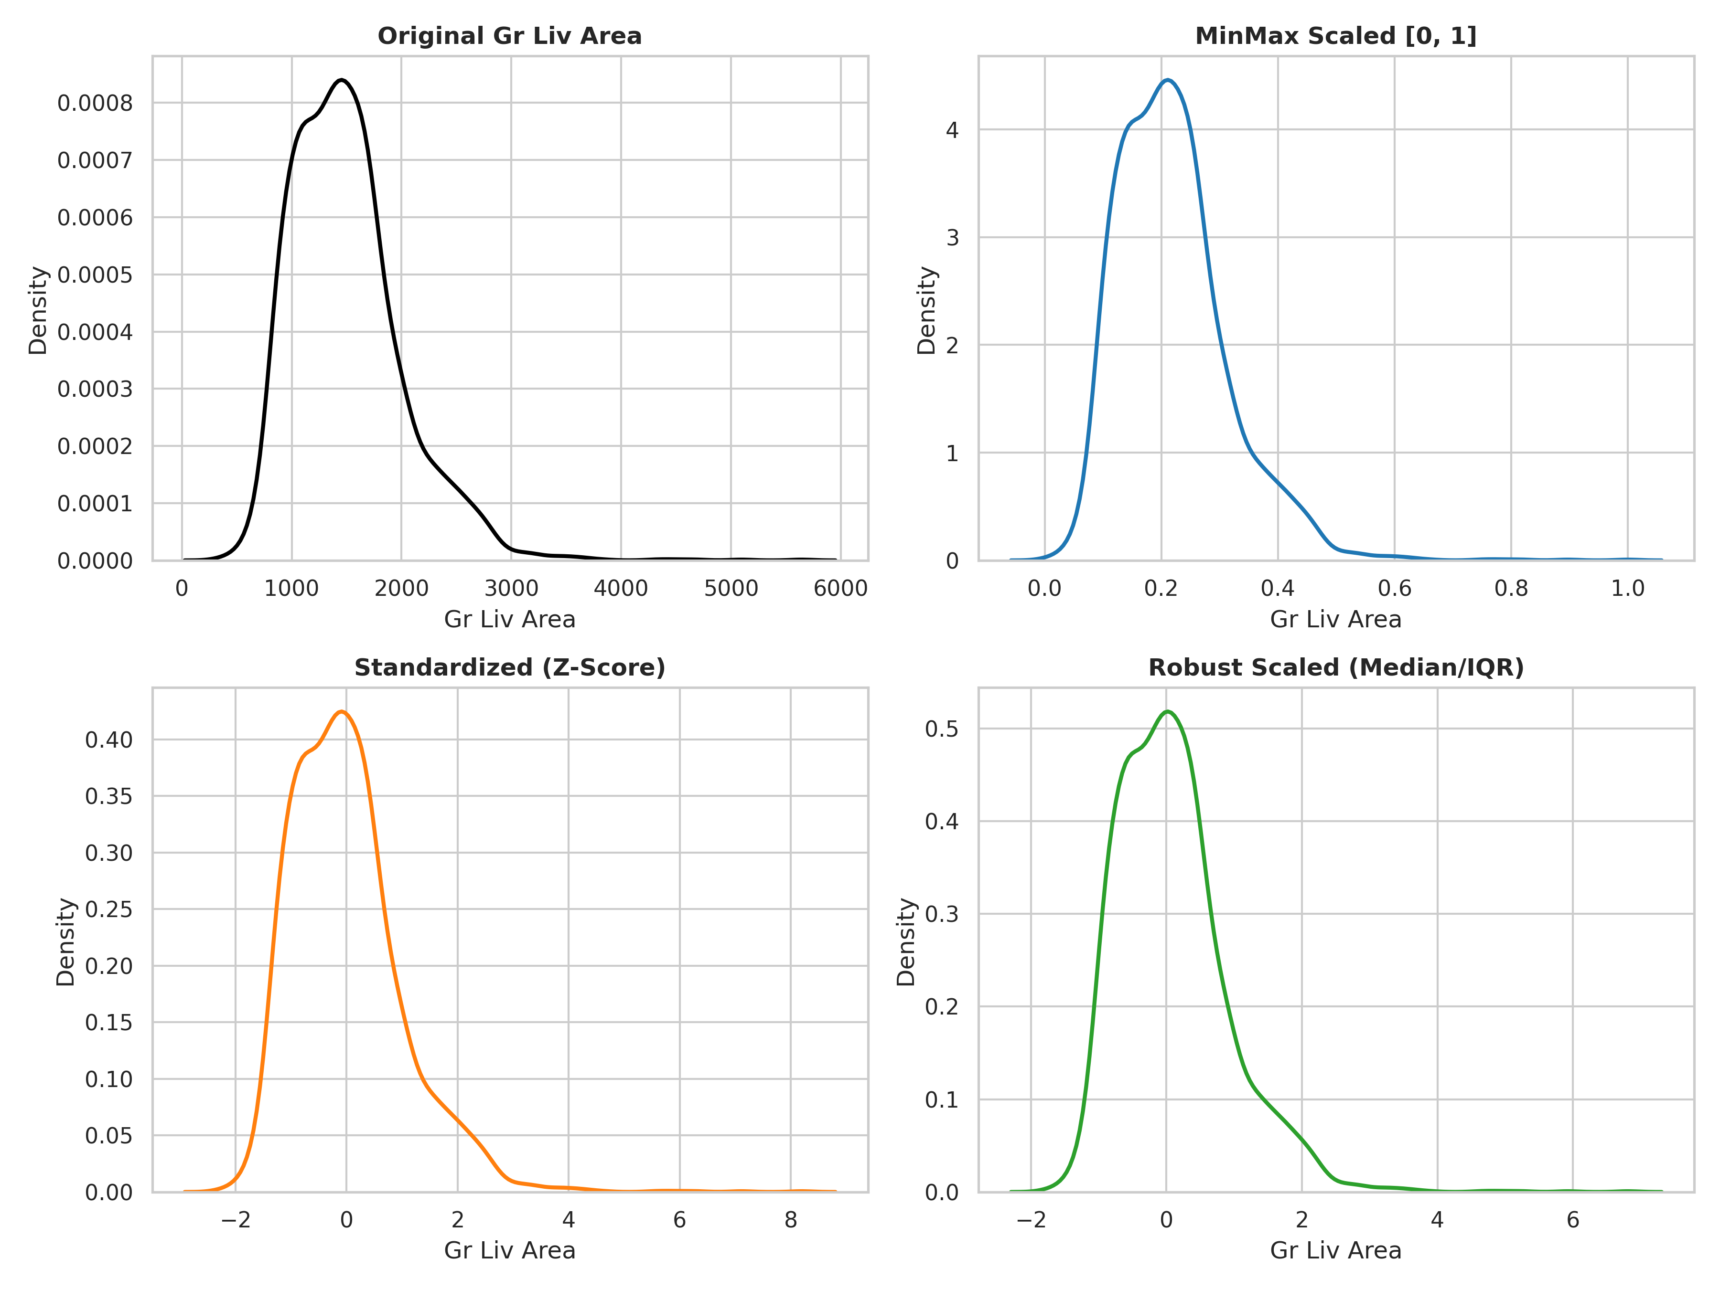
Results From Workflow
Sub-Module: Data Cleaning, Imputation & Feature Scaling (Weeks 3 & 6)
Data Cleaning & Preprocessing Milestones
Systematic Transformation from Raw to Verified Clean Data
• Domain-Specific Amenity Imputation: Identified that missing categorical values in property amenities (PoolQC, MiscFeature, Alley, Fence, FireplaceQu, GarageType, BsmtQual) reflect physical absence rather than unrecorded data -> Imputed with 'None'.
• Zero-Value Physical Imputation: Corresponding physical dimension features (GarageArea, GarageCars, TotalBsmtSF, MasVnrArea) imputed with 0 when amenities are physically absent.
• 100% Missing Value Resolution: Successfully eliminated all 17,010 missing data cells without introducing synthetic data bias or record loss.
• Outlier Filtering & Hygiene: Identified and filtered 200 extreme non-arm's length transactions, partial transfers, and commercial parcels, establishing a clean 2,930-record baseline (0 nulls, 0 duplicates).
• Feature Scaling Evaluation (Week 6): Benchmarked StandardScaler (Z-score), MinMaxScaler, and RobustScaler (median & IQR). RobustScaler exhibited superior resilience against remaining heavy-tail square footage attributes.

Slide 8
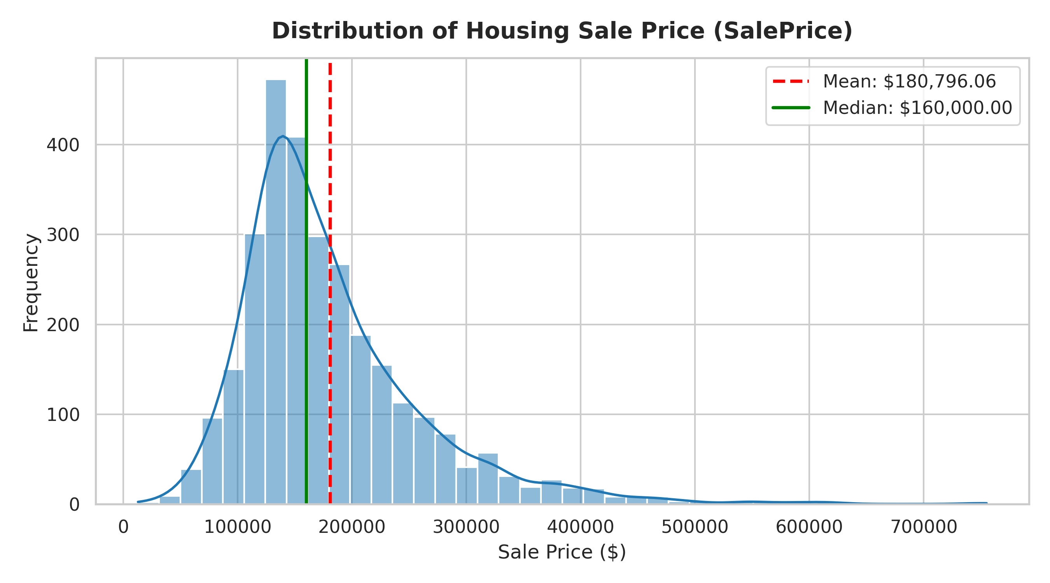
Results From Workflow
Sub-Module: Exploratory Data Analysis & Statistical Findings (Weeks 4 & 5)
EDA Insights & Statistical Discoveries
Distribution, Correlation & Valuation Drivers
• Central Tendency & Dispersion: SalePrice Mean: $180,796 vs. Median: $160,000 (IQR: $84,000, Std Dev: $79,887). The $20,796 gap demonstrates significant right-tail skew from luxury sales up to $755k.
• Target Skewness Mitigation: Raw SalePrice exhibits a severe positive skewness of +1.74. Applying log1p(SalePrice) restores near-perfect Gaussian symmetry (+0.12), stabilizing regression loss functions.
• Dominant Value Predictors: OverallQual is the single strongest linear predictor (r = 0.80), followed by GrLivArea (r = 0.71), GarageCars (r = 0.65), TotalBsmtSF (r = 0.63), and GarageArea (r = 0.64).
• Neighborhood Stratification: Substantial price segmentation across neighborhoods: High-tier enclaves (NridgHt, StoneBr) average > $310k, whereas entry-tier zones (MeadowV, IDOTRR) average < $120k.

Slide 9
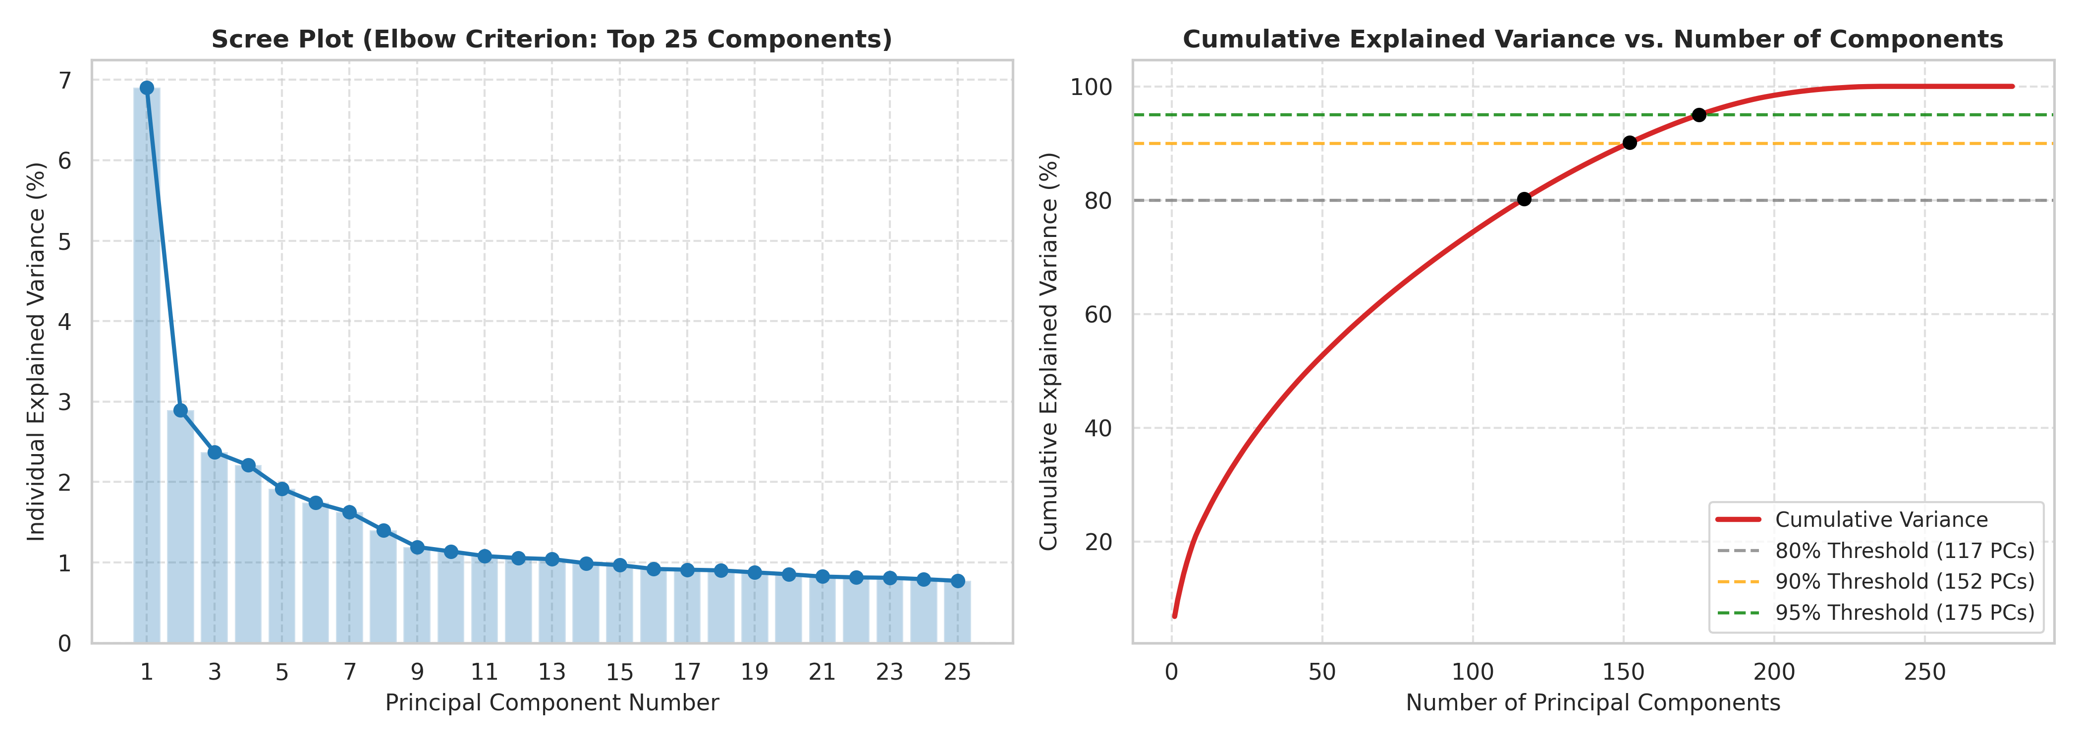
Expected Final Results
Dataset Readiness & Completed Deliverables
Production-Grade Pipeline Outputs (Weeks 1 to 7)
• 100% Cleaned & Imputed Dataset: 2,930 observations across 82 attributes with zero null cells and zero duplicates. Complete structural hygiene verified across every feature.
• Normalized Target Variable: SalePrice_Log achieves near-perfect Gaussian distribution (+0.12 skewness), preventing gradient explosion and predictive bias in linear models.
• Feature-Selected Matrix (Selected_Features_AmesHousing.csv): Curated 40 high-impact features selected via Random Forest importance and collinearity pruning (r < 0.85).
• Orthogonal PCA Matrix (PCA_Transformed_AmesHousing.csv): 175 principal components capturing 95.0% cumulative variance while eliminating multicollinearity entirely.
• Supervised Modeling Readiness: Leak-free, mathematically verified inputs ready for immediate benchmark training against regularized linear models and gradient boosted decision trees.

Slide 10
Roles & Responsibilities
Team Member & Registration | Key Roles, Weekly Deliverables & Syllabus Contributions
Tarun B S (25BAD123) | Data Analysis & Visualization Lead • Unit 1 & 2: Univariate, bivariate & multivariate exploratory data analysis. • Visual generation of distribution histograms, boxplots, and correlation heatmaps. • Unit 4: Scree plot, variance curve, and 2D/Biplot PCA projections.
Santhosh P (25BAD101) | Data Cleaning & Preprocessing Lead • Unit 2 Cleaning Sprint: Handled 17,010 missing data points across 82 columns. • Domain-specific amenity imputation ('None' / 0); anomaly and outlier identification. • Verified dataset hygiene (0 nulls, 0 duplicates across 2,930 clean records).
Siva Chandran R K (25BAD108) | Feature Engineering & Statistical Modeling Lead • Unit 3: Constructed 5 composite domain features; log1p transformation (+0.12 skewness). • Evaluated StandardScaler, MinMaxScaler, and RobustScaler on skewed features. • Unit 4: VarianceThreshold filtering, Random Forest feature selection & PCA implementation.
Santhosh M (25BAD100) | Documentation & Reporting Lead • Technical reports and documentation across Weeks 1 to 7. • Mid-review presentation compilation, template alignment, and visual styling. • Verification of syllabus mapping against 24ADI204 course outcomes.
Team 8 (Collaborative Effort) | Shared Team Responsibilities • Peer code review, GitHub version control management, and pipeline debugging. • Collaborative problem formulation, milestone tracking, and mid-review presentation delivery.

Slide 11
Challenges Faced
1. Missing Data Ambiguity vs. Absence of Amenity
Week 3 Cleaning Sprint
• Challenge: Standard missing-data tools interpret NaN as unrecorded observations. In Ames, NaN in PoolQC, Fence, FireplaceQu, GarageType, etc., indicates physical absence of that amenity.
• Resolution: Constructed domain rule dictionaries mapping categorical amenity nulls to 'None' and numerical counterparts (GarageArea, TotalBsmtSF) to 0, eliminating 17,010 nulls without distortion.
2. Extreme Skewness & Heavy-Tailed Outliers
Weeks 4 & 5 Statistical Audits
• Challenge: SalePrice exhibited severe positive skewness (+1.74) with extreme luxury sales ($755k), violating homoscedasticity and normality assumptions essential for linear models.
• Resolution: Applied log1p(SalePrice) reducing skewness to +0.12 (near-perfect normal curve), and removed 200 non-arm's length transactions and commercial zoning anomalies.
3. High-Dimensional Explosion & Sparsity
Week 6 Feature Encoding
• Challenge: One-Hot Encoding 33 nominal categorical attributes expanded feature dimensions from 82 to 293 columns, creating massive matrix sparsity and zero-variance columns.
• Resolution: Applied VarianceThreshold(0.01) to prune 88 quasi-constant zero-variance features, followed by orthogonal PCA decomposition retaining 95% variance across 175 components.
4. Severe Multicollinearity Among Physical Features
Week 7 Dimensionality Reduction
• Challenge: Intense collinearity between physical measurements (GarageCars vs. GarageArea r=0.89, TotalBsmtSF vs. 1stFlrSF r=0.80) destabilizes regression coefficients.
• Resolution: Synthesized composite domain metrics (TotalHouseArea, TotalBathrooms) and projected correlated features into orthogonal PCA eigenvectors.

Slide 12
Future Work & Conclusion
Project Conclusion & Milestones Achieved
Weeks 1 to 7 Deliverables & Key Learnings
• Structured Pipeline Execution: Successfully executed a 7-week end-to-end data science lifecycle, converting 3,130 dirty raw records into two production-grade prepared representations.
• Data Hygiene Restored: Differentiated structural absences from missing data (17k cells imputed) and eliminated 200 anomalies, establishing a 2,930 clean record baseline.
• Comprehensive EDA & Audit: Identified top linear value drivers (OverallQual r=0.80, GrLivArea r=0.71) and audited dispersion metrics.
• Feature Engineering & Normalization: Constructed 5 domain metrics, normalized price skewness (+0.12), and compared 3 scaling techniques.
• Dimensionality Reduction: Pruned 88 low-variance features and extracted 175 orthogonal PCA components capturing 95% variance.
• Core Takeaway: High-fidelity data engineering and dimensionality reduction ensure robust, leak-free inputs for downstream regression algorithms.
Future Roadmap (Weeks 8 to 12)
Supervised Modeling, Optimization & Deployment
• 1. Supervised Regression Benchmarking:
• Train and benchmark Regularized Linear Models (Ridge, Lasso, ElasticNet) against Gradient Boosted Decision Trees (Random Forest, XGBoost, LightGBM, CatBoost).
• Evaluate predictive accuracy on Selected Features (40 cols) vs. PCA Matrix (175 PCs).
• 2. Hyperparameter Optimization & Validation:
• Implement 5-Fold Cross Validation with Bayesian Optimization / Optuna to minimize Root Mean Squared Error (RMSE) and Mean Absolute Error (MAE).
• 3. Model Interpretability & Explainability (XAI):
• Utilize SHAP (SHapley Additive exPlanations) and Partial Dependence Plots to explain price predictions transparently for end-users.
• 4. Interactive Web Application Deployment:
• Build an interactive real-time property valuation web dashboard using React/Vite and a containerized FastAPI backend.

Slide 13
References
Academic & Technical References
Literature, Industry Frameworks & Course Foundations
[•] De Cock, Dean (2011): Ames, Iowa: Alternative to the Boston Housing Data as an End of Semester Regression Project. Journal of Statistics Education, Vol. 19, No. 3, pp. 1-14. Description of dataset compilation, features, and educational usage.
[•] McKinney, Wes (2022): Python for Data Analysis: Data Wrangling with Pandas, NumPy, and Jupyter. 3rd Edition, O'Reilly Media. Foundation for data cleaning, structural reshaping, and numerical manipulation.
[•] Hastie, Trevor, Tibshirani, Robert, & Friedman, Jerome (2009): The Elements of Statistical Learning: Data Mining, Inference, and Prediction. 2nd Edition, Springer Series in Statistics. Mathematical foundations for dimensionality reduction, PCA variance, and feature regularization.
[•] Pedregosa, Fabian, et al. (2011): Scikit-learn: Machine Learning in Python. Journal of Machine Learning Research, Vol. 12, pp. 2825-2830. Core algorithmic implementations of VarianceThreshold, PCA, StandardScaler, and Random Forest feature selection.
[•] Kaggle Housing Data Competition: House Prices: Advanced Regression Techniques. Kaggle Community Benchmark Repository. Standards for handling Ames housing ordinal scalings and logarithmic target transformations.
[•] Department of Artificial Intelligence & Data Science (2026): 24ADI204 – Data Science and Visualization Course Curriculum and Lab Manual. Bannari Amman Institute of Technology. Course syllabus mapping across Units 1 to 4.

